Slide 1
MoDist: Motion Distillation for Self-supervised Video Representation Learning
Fanyi Xiao, Joseph Tighe, Davide Modolo

Slide 2
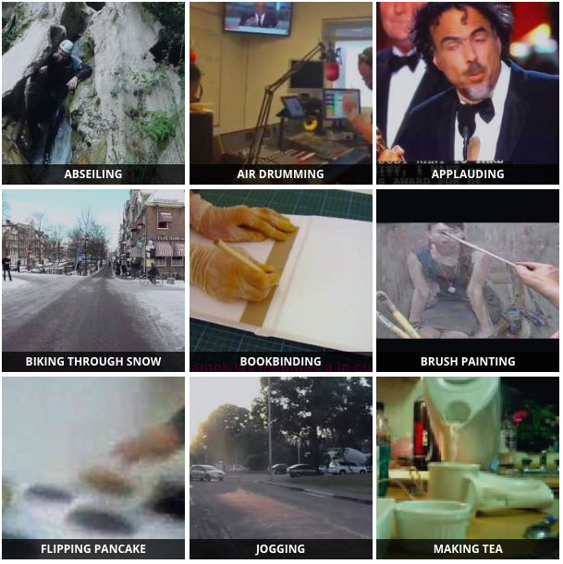
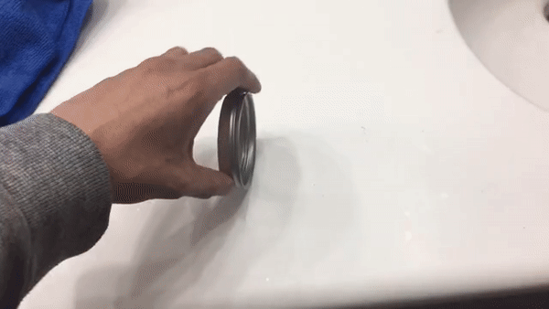
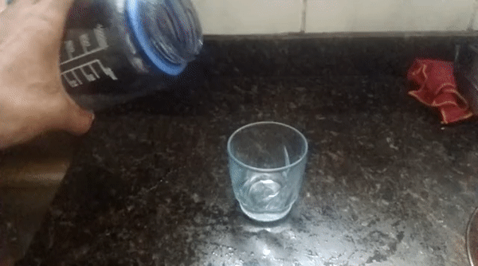
Why self-supervised?
Spinning a bracelet so it continues spinning
Pulling two ends of a rubber band so that it gets stretched
Large domain gap
Trying to pour water into a glass, but missing so it spills next to it
Pretrain on Kinetics 400
Finetune on Something-Something
Self-supervised learning helps avoid taxonomy bias, which is inevitable with supervised pretraining.

Slide 3
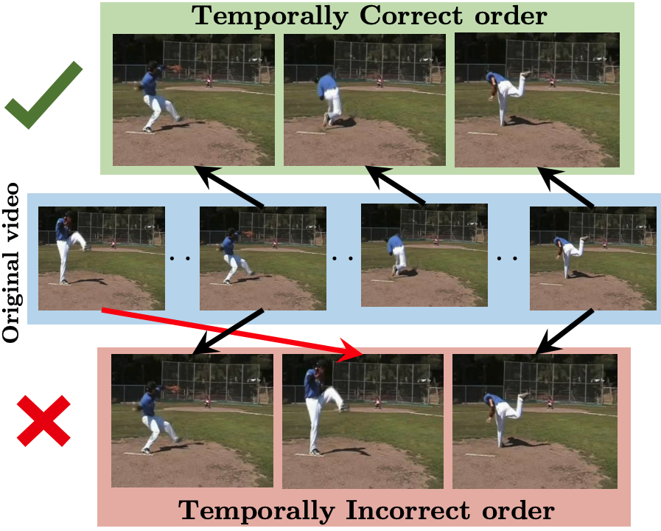
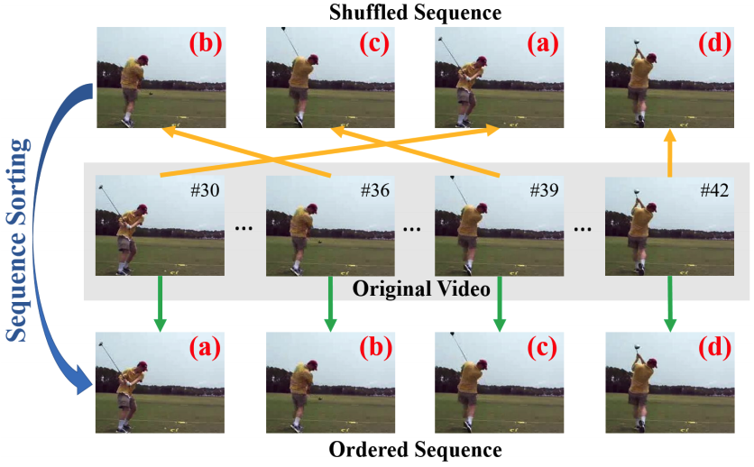
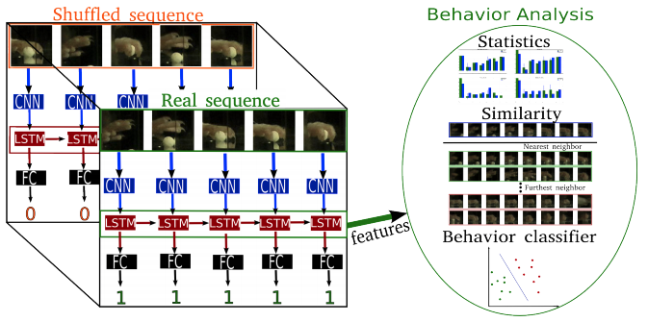
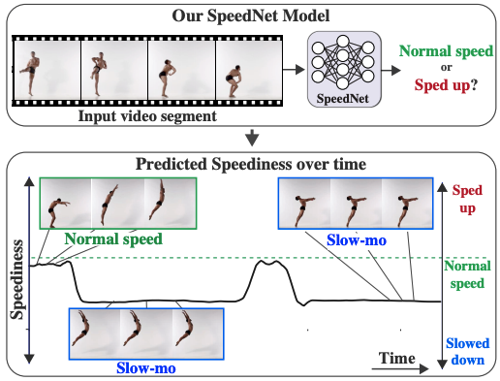
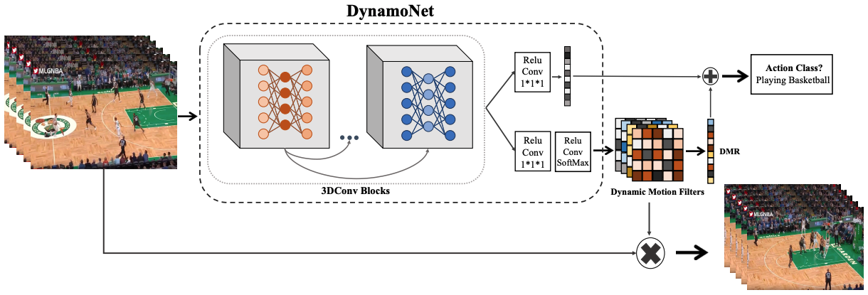
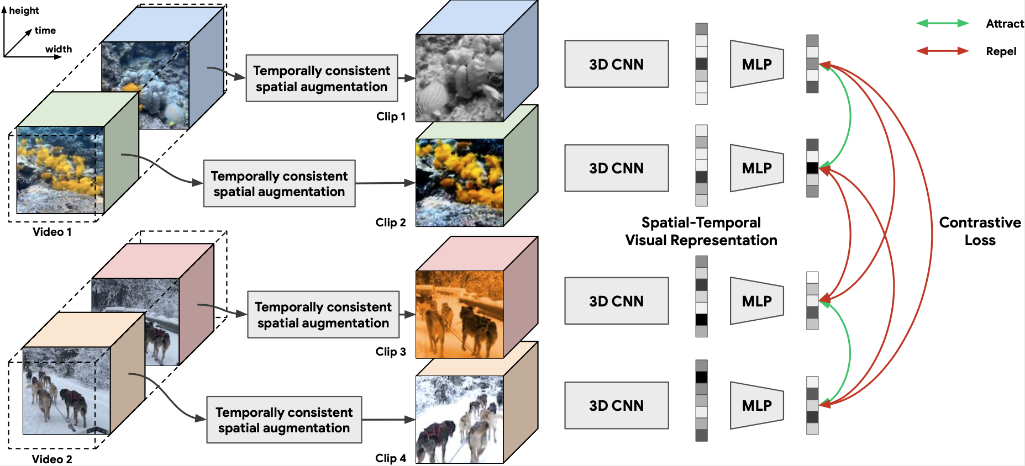
Self-supervised Video Representation Learning
Brattoli et al. [CVPR 17]
OPN [ICCV 17]
Shuffle&Learn [ECCV 16]
DynamoNet [ICCV 19]
CVRL [CVPR 21]
SpeedNet [CVPR 20]
Notes:
First three work uses human defined “pretext” task, which might not be optimal for learning useful representations

Slide 4
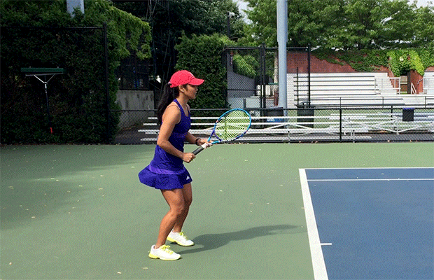
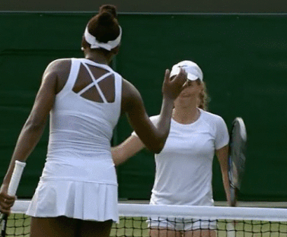
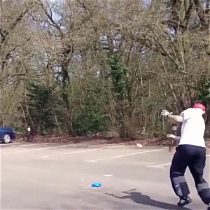
Motivation: Motion modeling is important for video representations
GT: Greeting
Pred: Playing Tennis
GT: Playing Tennis
GT: Playing Tennis
Pred: Parking Car
Training
Supervised motion modeling for videos:
[Feichtenhofer et al., NeurIPS 2016]
[Feichtenhofer et al., CVPR 2016]
Testing
[Wang et al., ECCV 2016]
…….

Slide 5
Approach

Slide 6
Visual-to-Visual Contrastive Learning
Visual CNN
Visual CNN
Visual CNN
Visual CNN
Repeal
Attract
We adopt a visual-to-visual contrastive learning objective operating on RGB clips

Slide 7
Motion-to-Visual Distillation Learning
Repeal (V2V)
Attract (V2V)
Motion CNN
Repeal (MV)
Attract (MV)
Visual CNN
Visual CNN
Visual CNN
Visual CNN
Motion CNN
We enrich visual-only learning with Motion-to-Visual distillation objective

Slide 8
Motion-to-Motion Contrastive Learning
Motion CNN
Motion CNN
We combine these three losses to form our final learning objective:
Motion CNN
Motion CNN
Repeal (M2M)
Attract (M2M)
We further add a Motion-to-Motion learning objective to improve discriminativeness of motion representations.

Slide 9
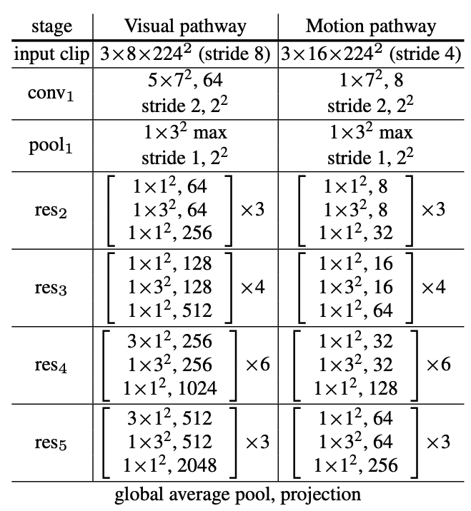
MoDist Network Architectures
Motion CNN
8x
Visual CNN
Visual CNN
Visual CNN
Visual CNN
Motion CNN
R50 backbone used for both pathways
Notes:
- Motion CNN is a much more lightweight network (1/8 of the channels for all layers compared to Visual CNN)
Visual CNN is a R3D-50 model with [5, 1, 1, 3, 3] temporal kernel for each ResNet stages, it takes in 8x8 inputs

Slide 10
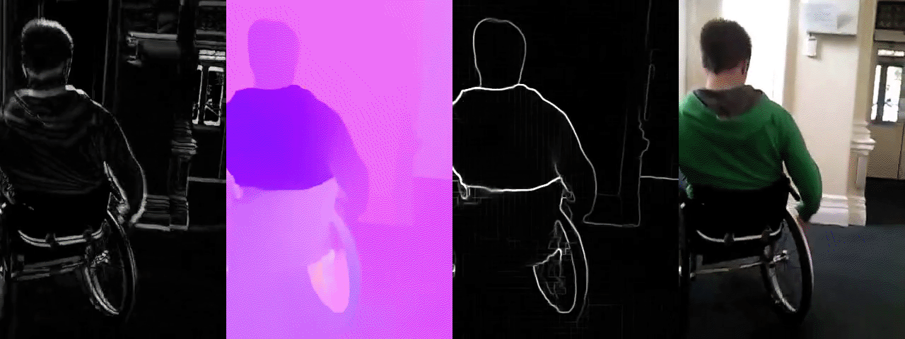
Design Motion Representations
(a)
(b)
(c)
(d)
From left to right: (a) Frame Difference (b) Optical Flow (c) Flow Edge (d) RGB inputs

Slide 11
Experiments

Slide 12
Training and Evaluating MoDist
We train on Kinetics-400 dataset of 240k clips of max length 10 secs. We do not use Kinetics labels.
With the pretrained representation, we transfer to target datasets and evaluate with Linear and Full protocols.
Across experiments, we compare to two important baselines:
RGB-only self-supervised contrastive learning (i.e., trained with only )
Supervised pretraining that utilizes Kinetics labels
Notes:
Protocol: SSL pretrain on K400 and then freeze the backbone and train a linear classifier on top for UCF/HMDB

Slide 13
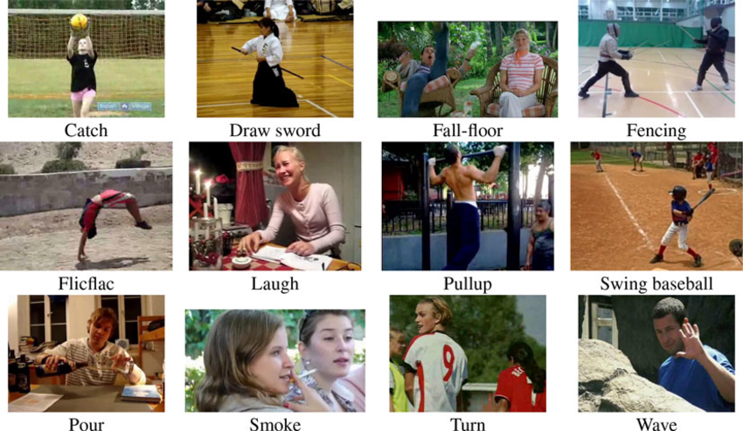
Action Recognition on UCF101 and HMDB51
There are 3.5k/1.5k train/test videos with 51 classes for HMDB51
There are 9.5k/3.7k train/test videos with 101 classes for UCF101
Notes:
Protocol: SSL pretrain on K400 and then freeze the backbone and train a linear classifier on top for UCF/HMDB

Slide 14
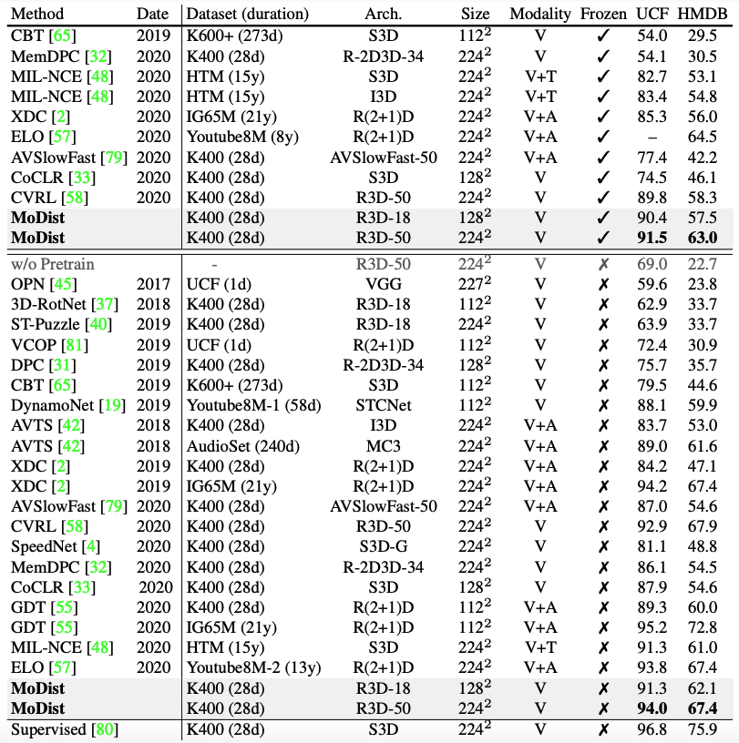
Compare to SOTA methods
We compare to methods use both Linear and Full protocols
We pretrain MoDist for 600 epochs for comparisons

Slide 15
Compare to SOTA methods
We compare to methods use both Linear and Full protocols
With Linear protocol, MoDist achieves better top-1 classification accuracy compared to the previous state-of-the-art trained on K400
Δ = +16.7/+16.9
Δ = +1.7/+4.7
We pretrain MoDist for 600 epochs for comparisons

Slide 16
Compare to SOTA methods
We compare to methods use both Linear and Full protocols
With Linear protocol, MoDist achieves better top-1 classification accuracy compared to the previous state-of-the-art trained on K400
Under Linear protocol, MoDist outperforms methods trained with 100x more data (IG65M and HTM), or use extra modality (audio and text)
We pretrain MoDist for 600 epochs for comparisons

Slide 17
Compare to SOTA methods
We compare to methods use both Linear and Full protocols
With Linear protocol, MoDist achieves better top-1 classification accuracy compared to the previous state-of-the-art trained on K400
Under Linear protocol, MoDist outperforms methods trained with 100x more data (IG65M and HTM), or use extra modality (audio and text)
Under Full protocol, MoDist again achieves SOTA among methods trained on K400. XDC and GDT produce results comparable to MoDist, but are either trained on 270×more data or use extra audio modality as inputs.
We pretrain MoDist for 600 epochs for comparisons

Slide 18
Compare to SOTA methods
We compare to methods use both Linear and Full protocols
With Linear protocol, MoDist achieves better top-1 classification accuracy compared to the previous state-of-the-art trained on K400
Under Linear protocol, MoDist outperforms methods trained with 100x more data (IG65M and HTM), or use extra modality (audio and text)
Under Full protocol, MoDist again achieves SOTA among methods trained on K400. XDC and GDT produce results comparable to MoDist, but are either trained on 270×more data or use extra audio modality as inputs.
Even with a weaker version, MoDist still convincingly outperforms models with similar backbone and input resolutions (e.g., 3D-RotNet, CBT, GDT, CoCLR) and even outperforms many methods that use larger backbones (e.g. XDC, AVSlowFast, etc.).
We pretrain MoDist for 600 epochs for comparisons

Slide 19
Ablation Studies on UCF101 and HMDB51
+14.6 / +13.5 for UCF / HMDB
+10.9 / +11.4 for UCF / HMDB
We pretrain for 100 epochs and evaluate with Linear protocol for all ablation studies
We test the effectiveness of Motion Distillation by comparing to RGB-only self-supervised baseline.
We vary the size of pretrain dataset, MoDist consistently outperform RGB-only with significant improvements.
MoDist trained on K400-mini already outperforms the RGB baseline trained with 4x more data (K400).
Notes:
Protocol: SSL pretrain on K400 and then freeze the backbone and train a linear classifier on top for UCF/HMDB

Slide 20
Ablation Studies on UCF101 and HMDB51
+14.6 / +13.5 for UCF / HMDB
+10.9 / +11.4 for UCF / HMDB
We evaluate different motion representations.
Flow Edges is indeed the best way to represent motion for self-supervised training, thanks to its ability to prune background motion noise and absolute motion magnitude.
Even the much weaker Frame Difference representation outperforms the RGB-only baseline by +8.0 top-1 accuracy on UCF and +6.4 on HMDB. Again demonstrate the effects of motion distillation.
Notes:
Protocol: SSL pretrain on K400 and then freeze the backbone and train a linear classifier on top for UCF/HMDB

Slide 21
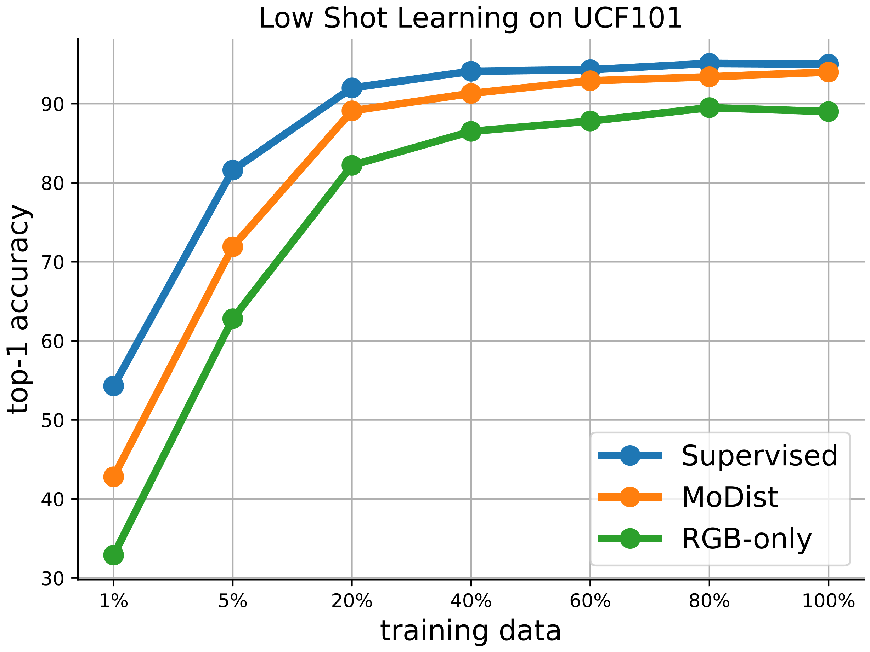
Low-Shot Learning with MoDist Representations
MoDist outperforms RGB-only across all training set sizes and it only requires 20% of the training videos to match the performance of RGB-only with 100%
We adopt Full Finetune protocol on UCF101
Notes:
This is the first result of generalizing self-supervised video representation to action detection task

Slide 22
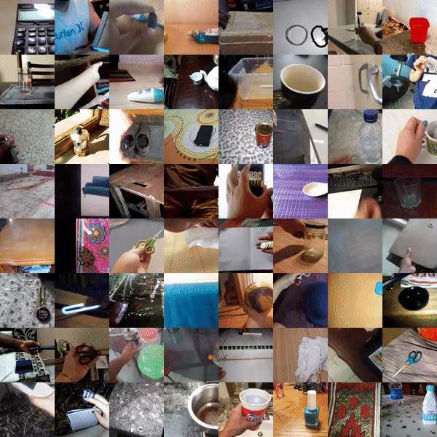
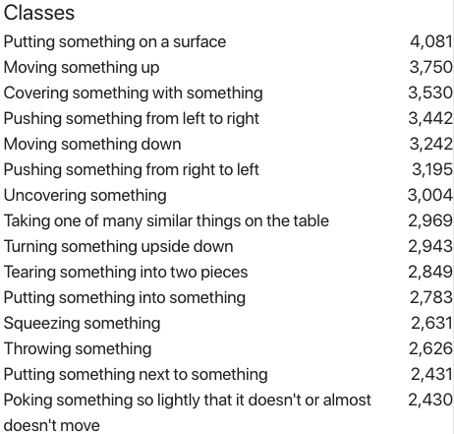
Overcoming Domain Gap: Transfer to Something-Something v2 Recognition
SSv2 contains videos with labels like "Putting [something] onto [something]"
There are 220,847 (168,913 for train) videos with 30,408 unique objects

Slide 23
Overcoming Domain Gap: Transfer to Something-Something v2 Recognition
Method | Pretrain data | Supervision | Top-1 Full | Top-5 Full | Top-1 Linear | Top-5 Linear
R3D-50 | K400 |  | 55.5 | 82.4 | 16.3 | 31.5
Rand Init | N/A | X | 45.4 | 74.8 | - | -
RGB-only | K400 | X | 54.9 | 81.5 | 16.6 | 38.4
MoDist | K400 | X | 57.4 | 83.7 | 27.1 | 53.6
Pretraining is important (+10%)
Gains for motion distillation is generalizable across datasets (+2.5%)
Self-supervised pretraining outperforms supervised pretraining (+1.9%)

Slide 24
Overcoming Domain Gap: Transfer to Something-Something v2 Recognition
Method | Pretrain data | Supervision | Top-1 Full | Top-5 Full | Top-1 Linear | Top-5 Linear
R3D-50 | K400 |  | 55.5 | 82.4 | 16.3 | 31.5
Rand Init | N/A | X | 45.4 | 74.8 | - | -
RGB-only | K400 | X | 54.9 | 81.5 | 16.6 | 38.4
MoDist | K400 | X | 57.4 | 83.7 | 27.1 | 53.6
Unsurprisingly accuracy for all methods are much lower compared to Full protocol.
Performance gain from motion distillation is further increased (+10.5% vs +2.5%).
Supervised baseline underperform both self-supervised methods, as it’s harder to overcome taxonomy bias under Linear protocol compared to the Full protocol for a representation pretrained with a fixed label taxonomy

Slide 25
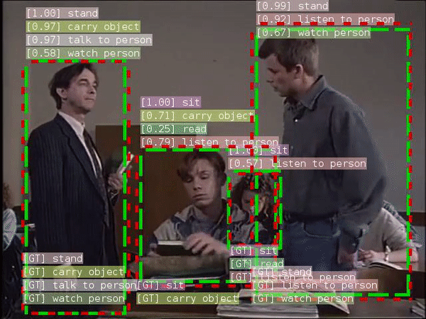
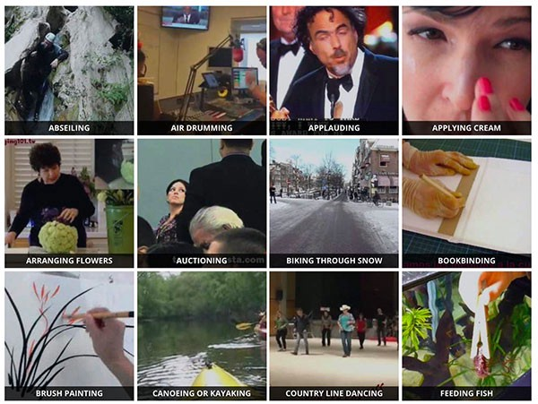
Transfer to AVA detection: Cross-task Generalization of the Video Representations
Transfer Learning
Kinetics
AVA
There is a domain difference when transferring representations learned without any localization annotation to the action detection task

Slide 26
Transfer to AVA detection: Cross-task Generalization of the Video Representations
 | Pretrain data | Supervision | mAP (%)
Video-Faster-RCNN | K400 |  | 21.9
Random Initialization | N/A | X | 6.6
CVRL [Qian et al. 2021] | K400 | X | 16.3
RGB-only | K400 | X | 18.6
Ours | K400 | X | 22.1
Detector backbone: 8x8 R3D-50 model, mAP is computed on AVA v2.2
Pretraining is critical for AVA detection, as random initialization gives very low accuracy
MoDist has a consistent gain compared to RGB-only
With Motion Distillation, SSL representation could be as effective as supervised pretraining
Notes:
This is the first result of generalizing self-supervised video representation to action detection task

Slide 27
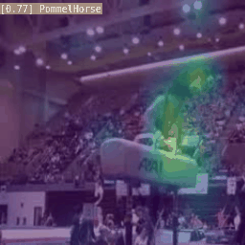
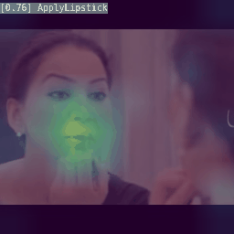
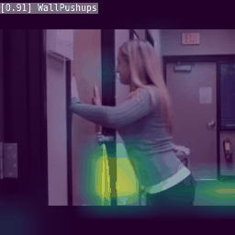
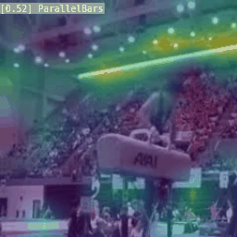
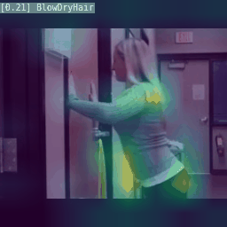
Visualizing MoDist Representations
MoDist
RGB-only
For each example, we show MoDist visualization in the top row and the visualization of RGB-only model in the bottom row. Predicted class and score are shown on the top-left of each example.

Slide 28
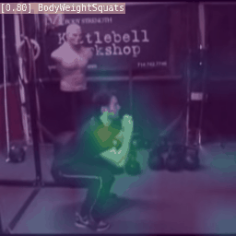
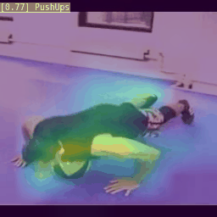
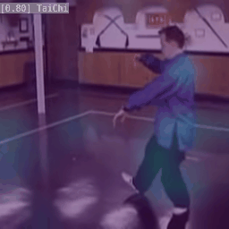
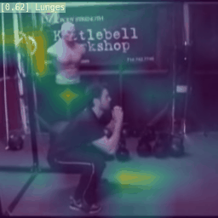
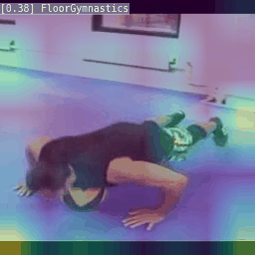
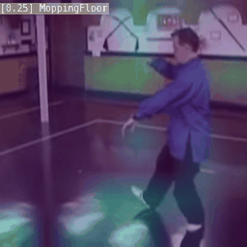
Visualizing MoDist Representations
MoDist
RGB-only
In left two examples, the background scene (gym) is associated with many fine-grained action classes, which leads to confusion for the RGB-only model whereas our MoDist model is able to distinguish actions by focusing on actual motion regions.

Slide 29
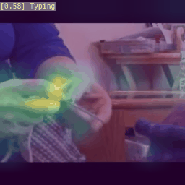
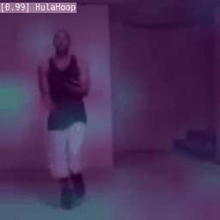
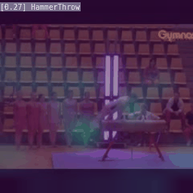
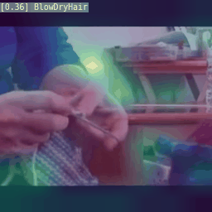
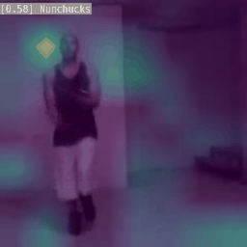
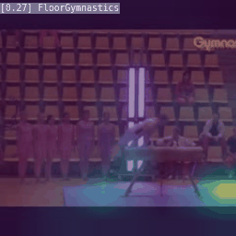
Visualizing MoDist Representations
MoDist
We demonstrated Motion Distillation can serve as an effective inductive bias for video self-supervised representation learning
We demonstrated the generalization of MoDist across datasets and tasks
Our results suggest MoDist can yield better representation even when compared to fully-supervised training
RGB-only
Note that in these examples, although our model correctly focused on motion regions, it got confused between similar motion patterns (e.g., confusing “Knitting” with “Typing” in the left example).

Slide 30
Thanks!
Questions?
Notes:
Okay, now let's look at an instance of multimodal learning on audiovisual data for the task of video recognition

